Slide 1
Reporting
1.baseline:Sift、HOG、Gabor;
2.one app visualization;
3.5 apps estimation: K-means、Hierarchical;
4.onother normalization;
5.design-style;

Slide 2
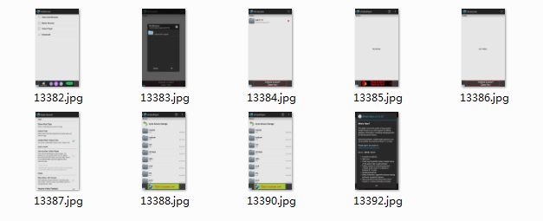
空白演示
1.afzkl.development.mVideoPlayer
在此输入您的封面副标题

Slide 3
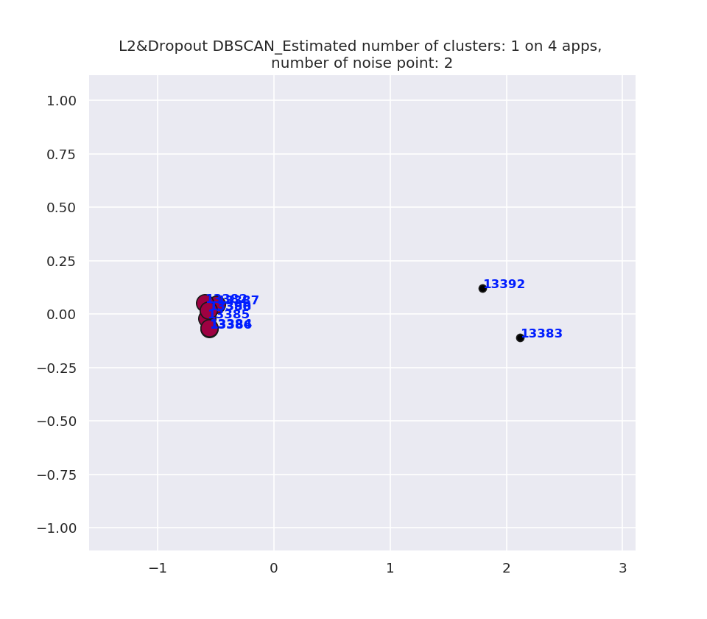
空白演示
Dbscan：eps: 0.5 min_samples: 4
L2&Dropout_max: 1003.0832
L2&Dropout_min: -1141.9109
reduced_data_max: 2.1179225
reduced_data_min: -0.59648657
在此输入您的封面副标题

Slide 4
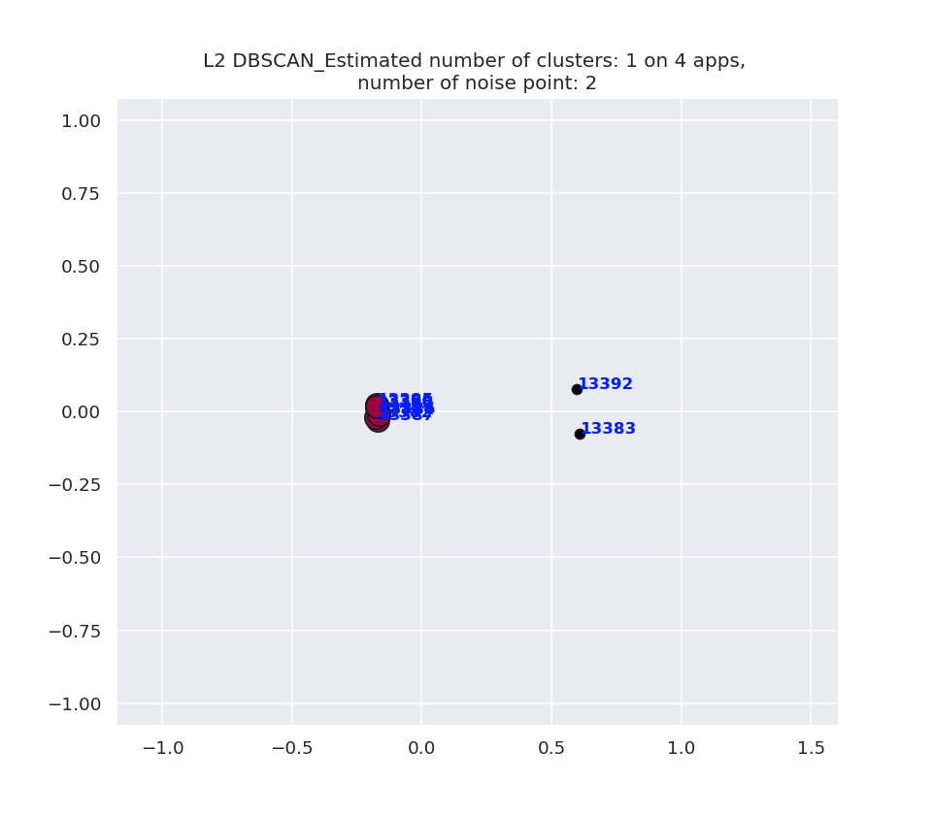
空白演示
Dbscan：eps: 0.5 min_samples: 4
L2_max: 252.71872
L2_min: -486.11053
reduced_data_max: 0.6068324
reduced_data_min: -0.17657495
在此输入您的封面副标题

Slide 5
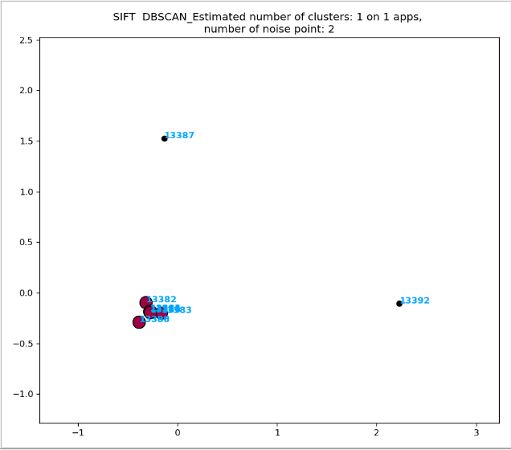
空白演示
Dbscan：eps: 0.5 min_samples: 4
SIFT_min: 0
SIFT_max: 27
reduced_data_max:
2.3295574129392063
reduced_data_min:
-0.4223710619498475
在此输入您的封面副标题

Slide 6
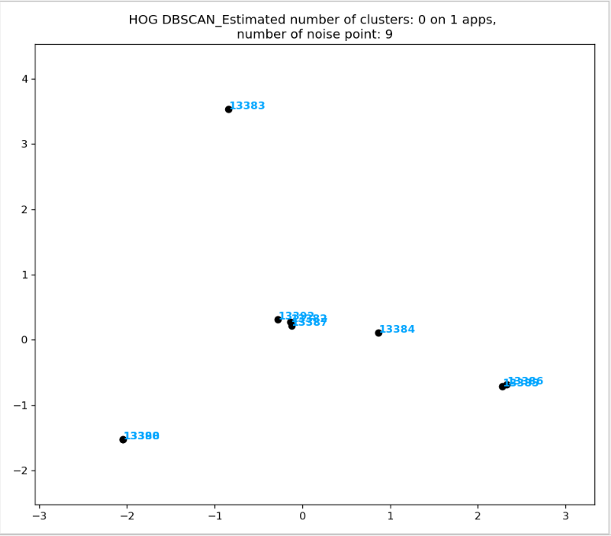
空白演示
Dbscan：eps: 0.5 min_samples: 4
HOG_min: 0
HOG_max: 0.9999230828369604
reduced_data_max:
3.5296208184868947
reduced_data_min:
-2.0451161495744374
在此输入您的封面副标题

Slide 7
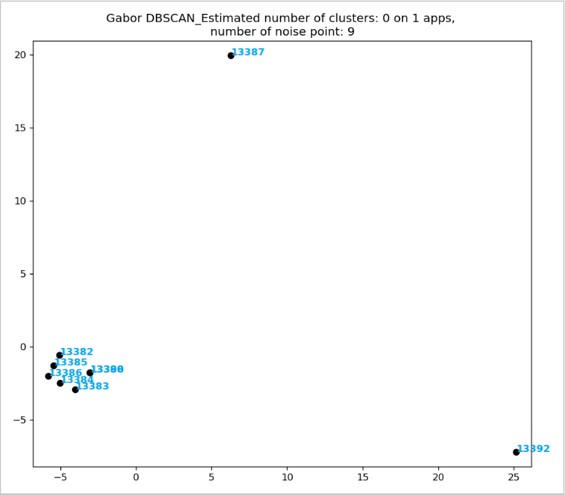
空白演示
Dbscan：eps: 0.5 min_samples: 4
Gabor_min: 0.13743937967672473
Gabor_max: 1.8984398305421262e-06
reduced_data_max:
25.161664478461333
reduced_data_min:
-7.209058275759379
在此输入您的封面副标题

Slide 8
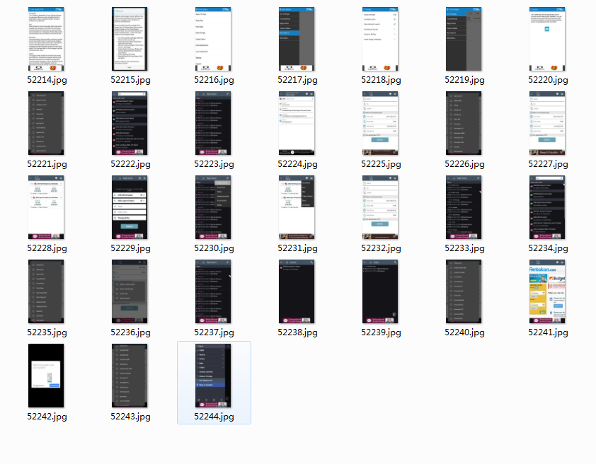
空白演示
2.air.com.thetourtracker.atoc2012
在此输入您的封面副标题

Slide 9
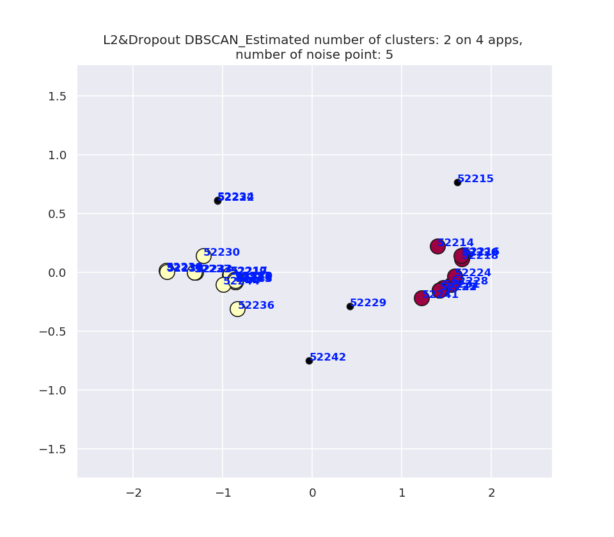
空白演示
Dbscan：eps: 0.5 min_samples: 4
L2&Dropout_max: 1082.0306
L2&Dropout_min: -1291.6239
reduced_data_max: 1.682803
reduced_data_min: -1.6311325
在此输入您的封面副标题

Slide 10
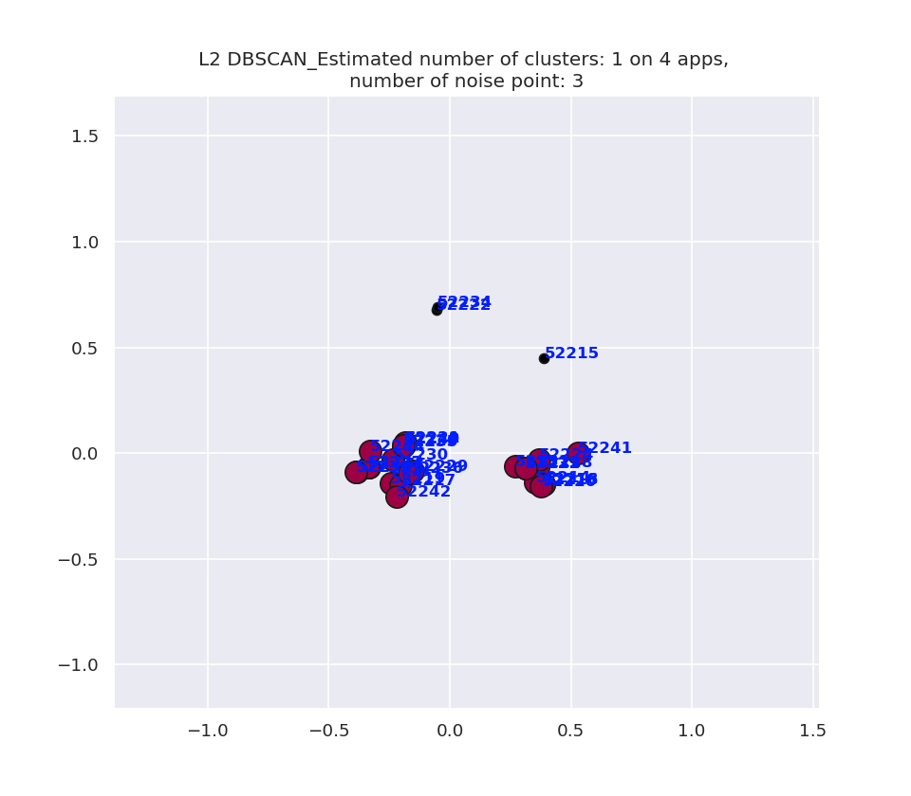
空白演示
Dbscan：eps: 0.5 min_samples: 4
L2_max: 426.56223
L2_min: -618.4571
reduced_data_max: 0.6912007
reduced_data_min: -0.38675135
在此输入您的封面副标题

Slide 11
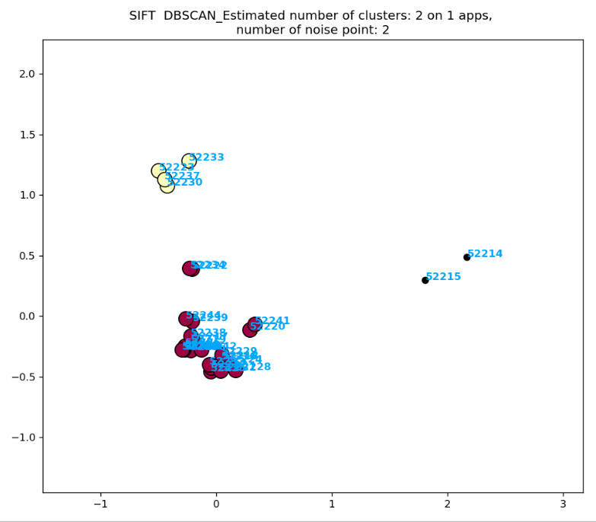
空白演示
Dbscan：eps: 0.5 min_samples: 4
SIFT_min: 0
SIFT_max: 41
reduced_SIFT_max:
1.5587298987156344
reduced_SIFT_min:
-0.7341405881048972
在此输入您的封面副标题

Slide 12
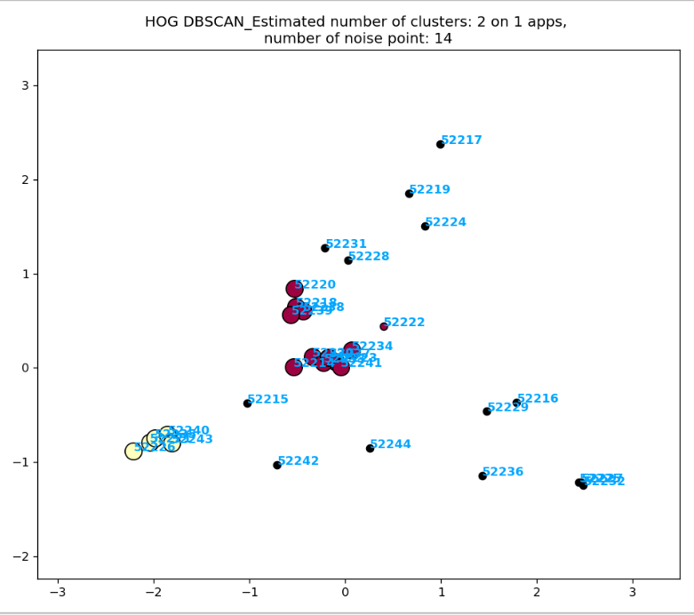
空白演示
Dbscan：eps: 0.5 min_samples: 4
HOG_min: 0
HOG_max: 0.9999878420929643
reduced_HOG_max:
2.4850469434272973
reduced_HOG_min:
-2.2089050400955337
在此输入您的封面副标题

Slide 13
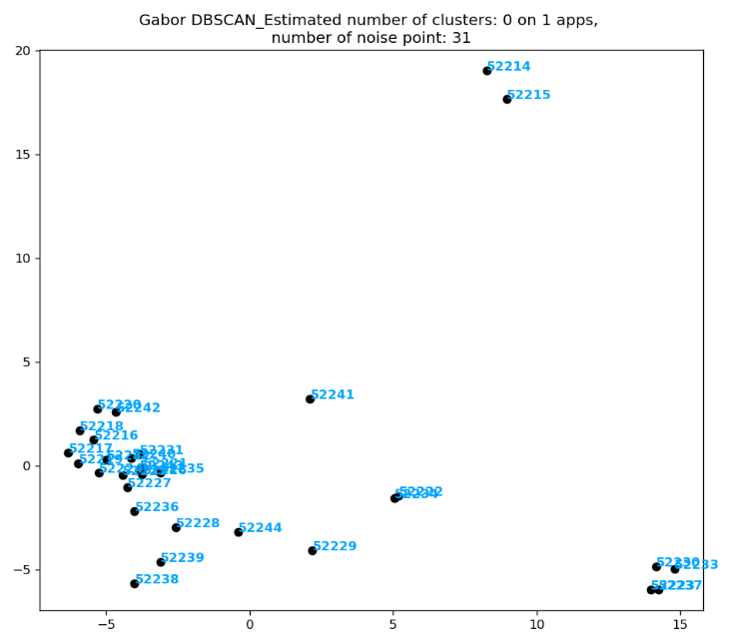
空白演示
Dbscan：eps: 0.5 min_samples: 4
Gabor_min: 0.0
Gabor_max: 0.169626051348187
reduced_Gabor_max:
19.038544573880714
reduced_Gabor_min:
-6.312662996148885
在此输入您的封面副标题

Slide 14
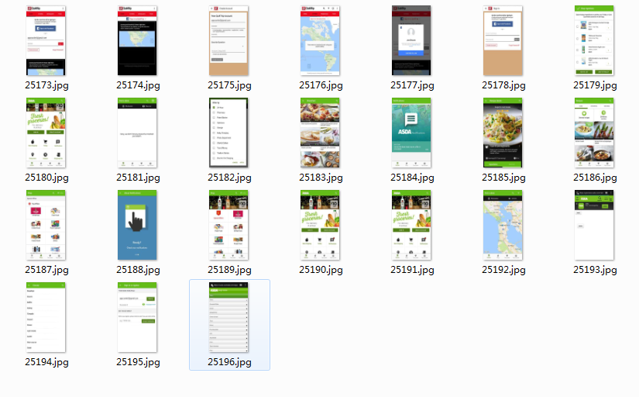
空白演示
3.app.quiktrip.com.quiktrip
在此输入您的封面副标题

Slide 15
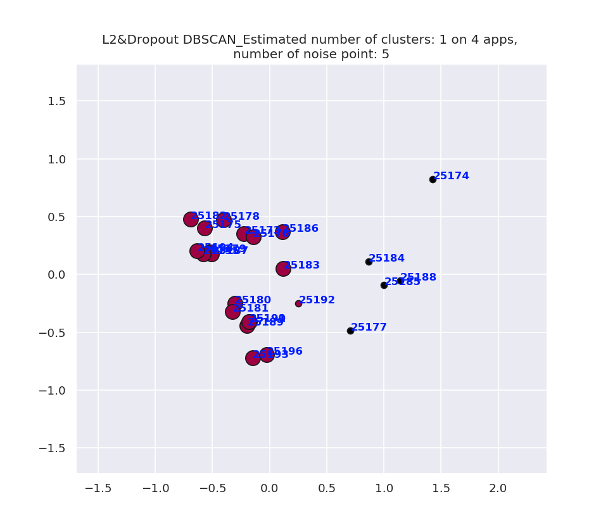
空白演示
Dbscan：eps: 0.5 min_samples: 4
L2&Dropout_max: 1083.254
L2&Dropout_min: -1330.578
reduced_data_max: 1.4276307
reduced_data_min: -0.72087324
在此输入您的封面副标题

Slide 16
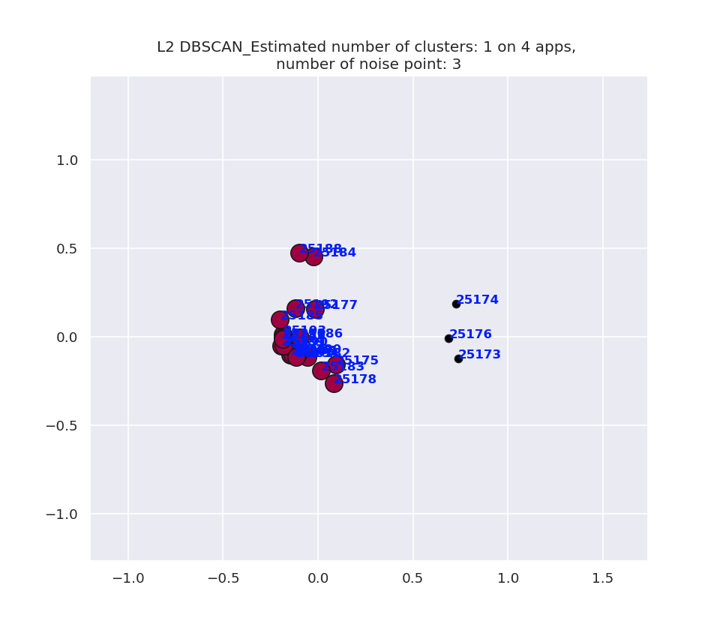
空白演示
Dbscan：eps: 0.5 min_samples: 4
L2_max: 449.14212
L2_min: -804.1384
reduced_data_max: 0.7377035
reduced_data_min: -0.26347923
在此输入您的封面副标题

Slide 17
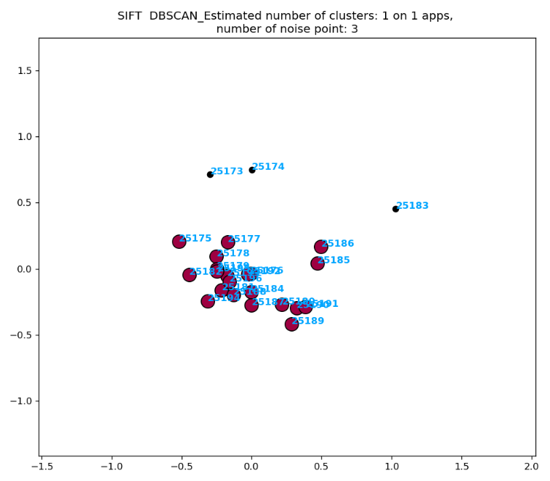
空白演示
Dbscan：eps: 0.5 min_samples: 4
SIFT_min: 0
SIFT_max: 47
reduced_SIFT_max:
1.0299376962442568
reduced_SIFT_min:
-0.5199072514613841
在此输入您的封面副标题

Slide 18
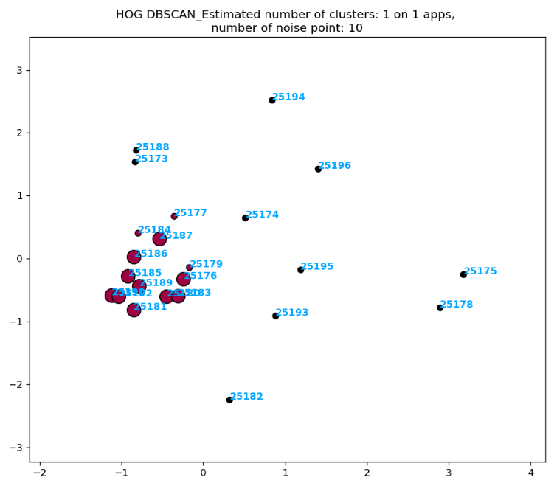
空白演示
Dbscan：eps: 0.5 min_samples: 4
HOG_min: 0
HOG_max: 0.9998461775055109
reduced_HOG_max:
3.1782499309183647
reduced_HOG_min:
-2.2391063672877256
在此输入您的封面副标题

Slide 19
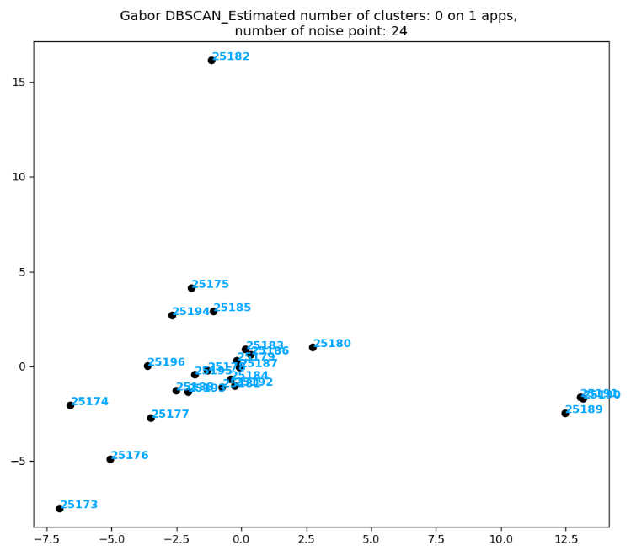
空白演示
Dbscan：eps: 0.5 min_samples: 4
Gabor_min: 0.0
Gabor_max: 0.18327439998750675
reduced_Gabor_max:
16.148804309596933
reduced_Gabor_min:
-7.481005484550179
在此输入您的封面副标题

Slide 20
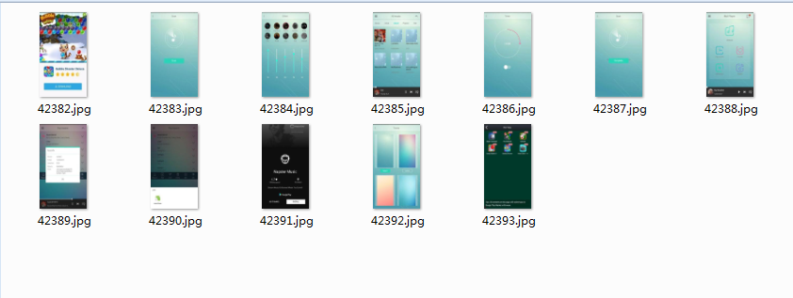
空白演示
4..audio.mp3.mp3player
在此输入您的封面副标题

Slide 21
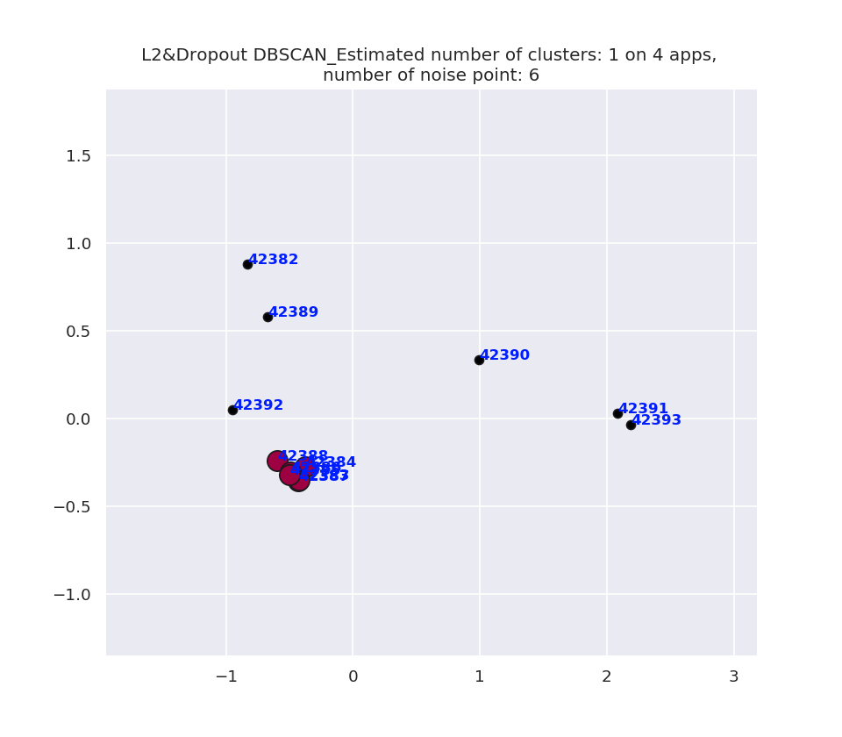
空白演示
Dbscan：eps: 0.5 min_samples: 4
L2&Dropout_max: 894.8831
L2&Dropout_min: -1082.8407
reduced_data_max: 2.188008
reduced_data_min: -0.95046186
在此输入您的封面副标题

Slide 22
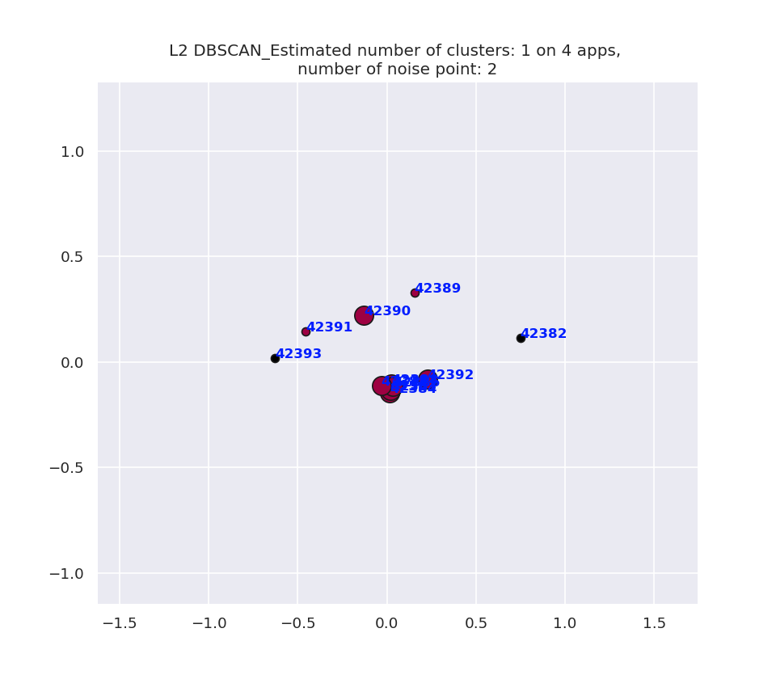
空白演示
Dbscan：eps: 0.5 min_samples: 4
L2_max: 309.17972
L2_min: -413.51624
reduced_data_max: 0.747786
reduced_data_min: -0.6265093
在此输入您的封面副标题

Slide 23
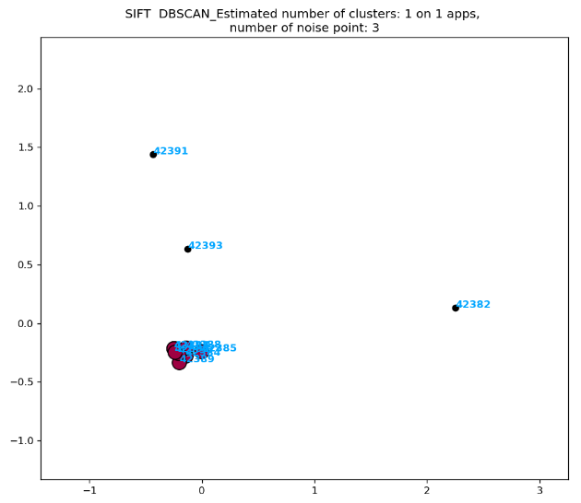
空白演示
Dbscan：eps: 0.5 min_samples: 4
SIFT_min: 0
SIFT_max: 19
reduced_SIFT_max:
2.2534774316888653
reduced_SIFT_min:
-0.43227694929697985
在此输入您的封面副标题

Slide 24
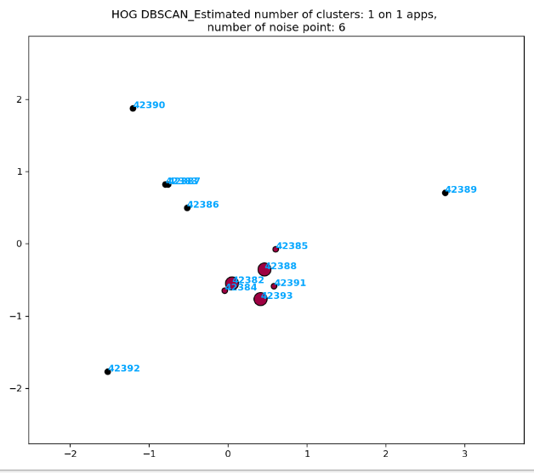
空白演示
Dbscan：eps: 0.5 min_samples: 4
HOG_min: 0
HOG_max: 0.9998666844473713
reduced_HOG_max:
2.747439897689919
reduced_HOG_min:
-1.7722706337655985
在此输入您的封面副标题

Slide 25
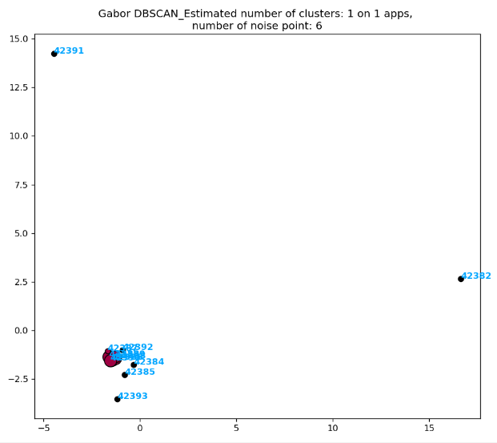
空白演示
Dbscan：eps: 0.5 min_samples: 4
Gabor_min: 7.292113332654475e-07
Gabor_max: 0.19653068139269525
reduced_Gabor_max:
16.64006431224217
reduced_Gabor_min:
-4.47676811686313
在此输入您的封面副标题

Slide 26
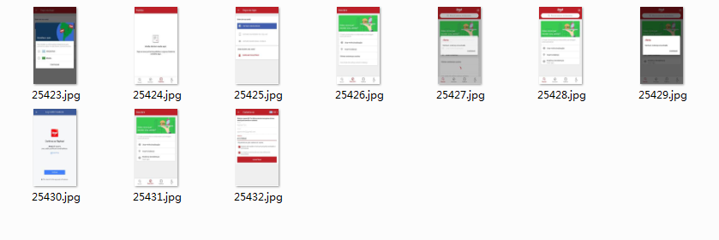
空白演示
5..br.com.brainweb.ifood
在此输入您的封面副标题

Slide 27
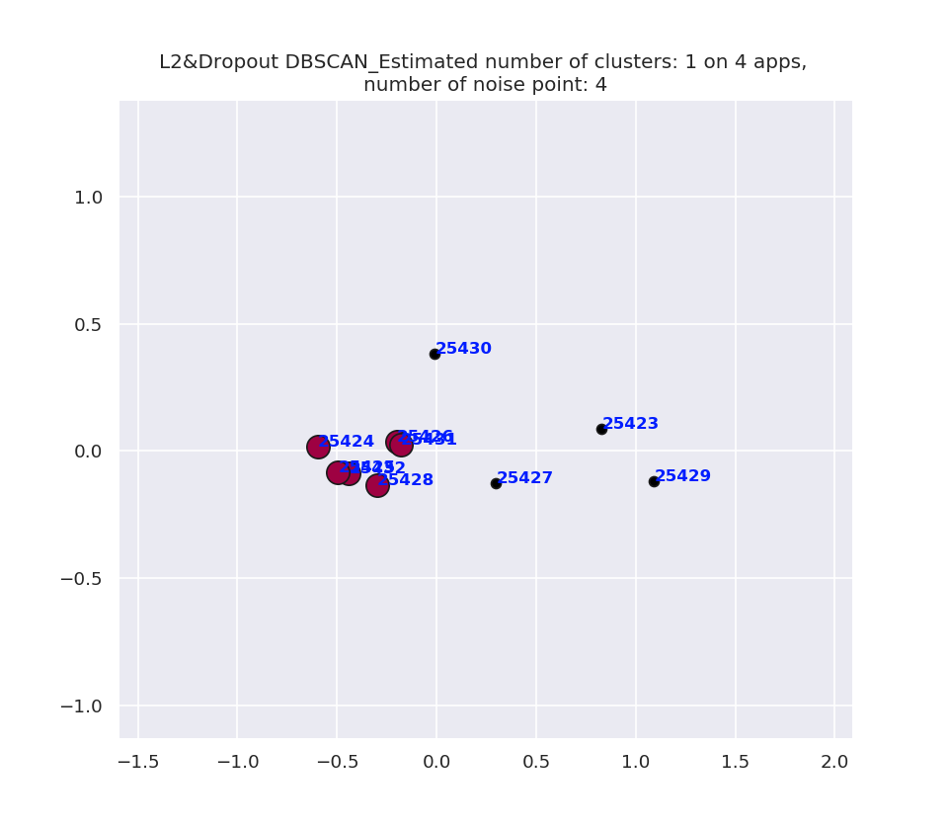
空白演示
Dbscan：eps: 0.5 min_samples: 4
L2&Dropout_max: 1058.3424
L2&Dropout_min: -1311.2222
rreduced_data_max: 1.092189
reduced_data_min: -0.5969271
在此输入您的封面副标题

Slide 28
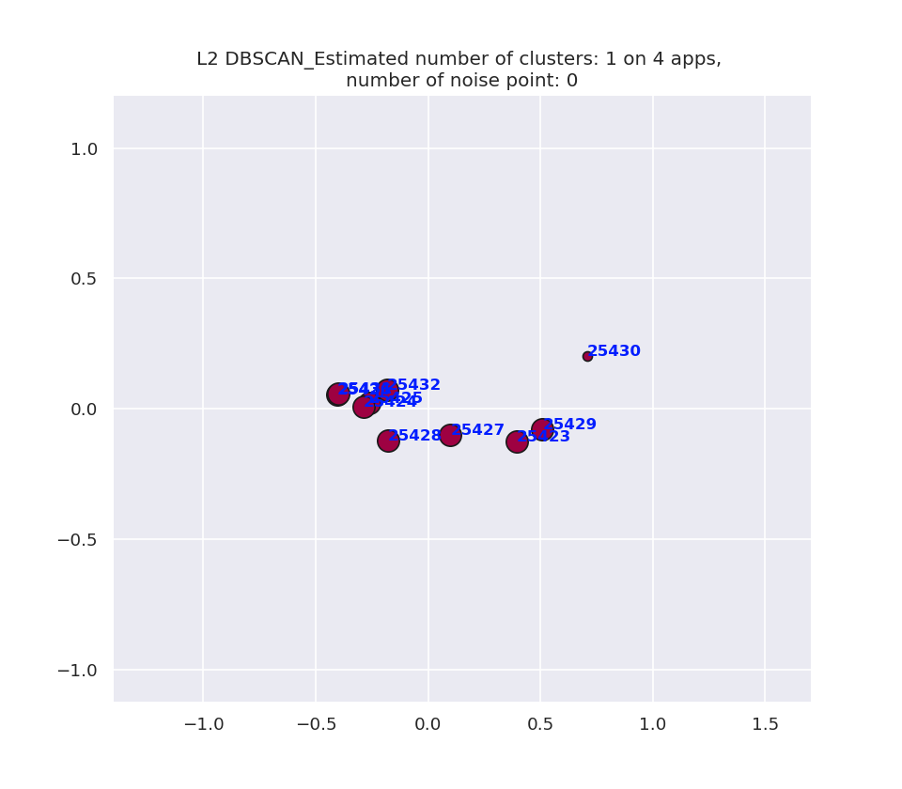
空白演示
Dbscan：eps: 0.5 min_samples: 4
L2_max: 1142.3146
L2_min: -729.38837
reduced_data_max: 0.70852023
reduced_data_min: -0.4032966
在此输入您的封面副标题

Slide 29
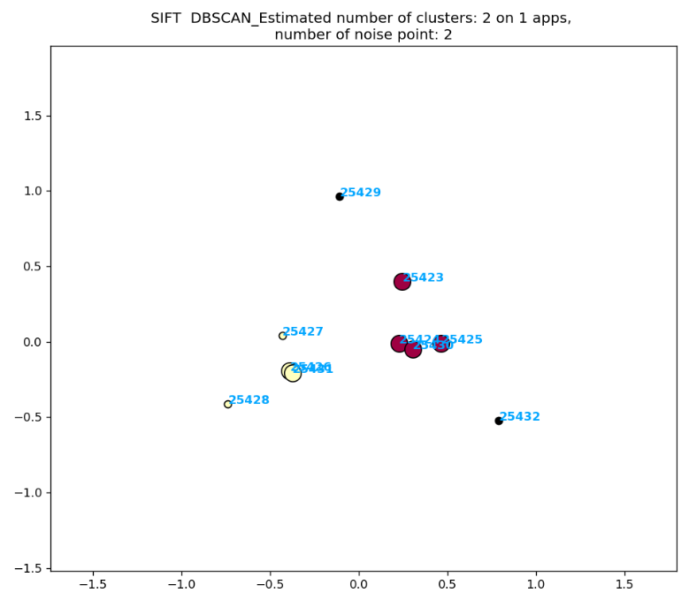
空白演示
Dbscan：eps: 0.5 min_samples: 4
SIFT_min: 0
SIFT_max: 19
reduced_SIFT_max:
0.9625763361435441
reduced_SIFT_min:
-0.7380112243056606
在此输入您的封面副标题

Slide 30
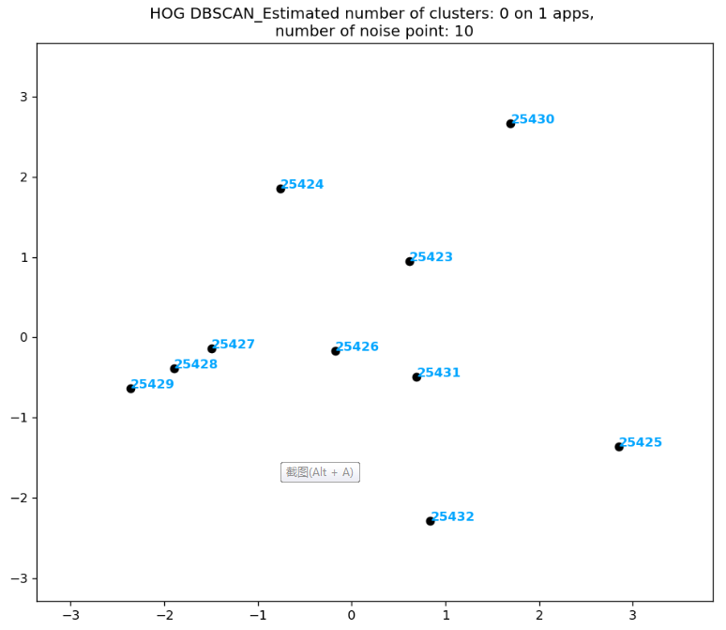
空白演示
Dbscan：eps: 0.5 min_samples: 4
HOG_min: 0
HOG_max: 0.9998400255959047
reduced_HOG_max:
2.8502358803784946
reduced_HOG_min:
-2.3601097389065706
在此输入您的封面副标题

Slide 31
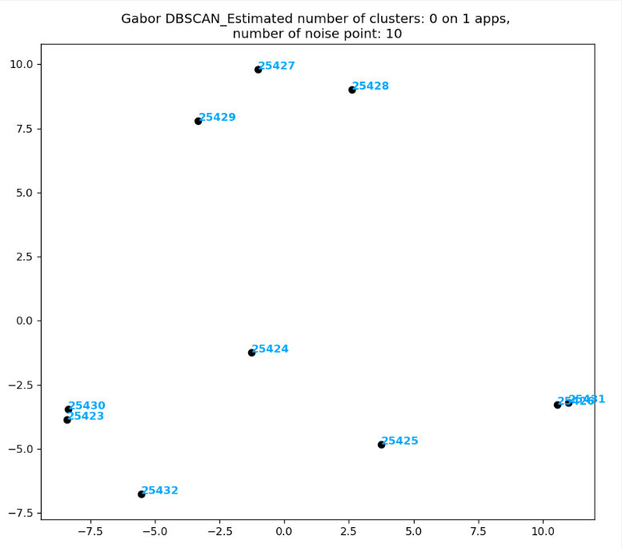
空白演示
Dbscan：eps: 0.5 min_samples: 4
Gabor_min: 7.103251115511368e-07
Gabor_max: 0.10990646536909057
reduced_Gabor_max:
10.98563405397936
reduced_Gabor_min:
-8.4081165456986
在此输入您的封面副标题

Slide 32
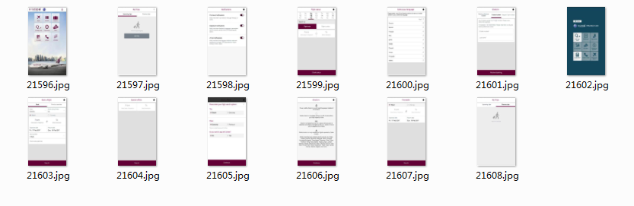
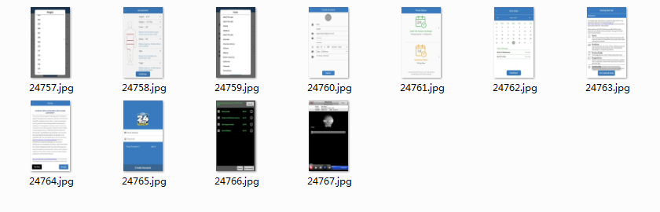
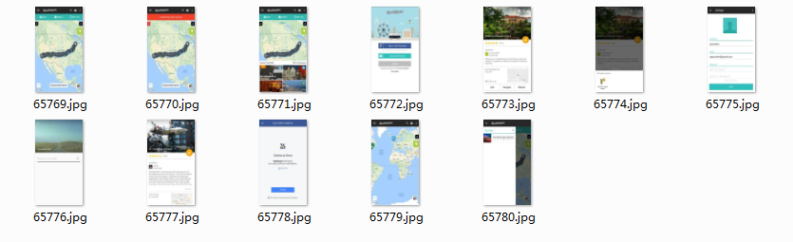
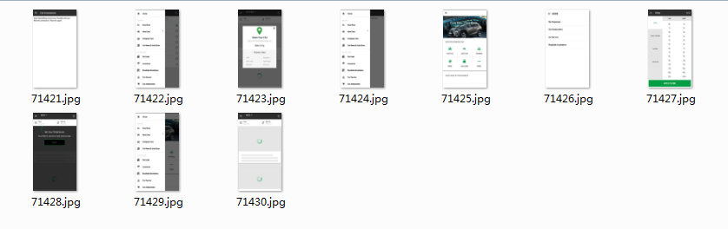
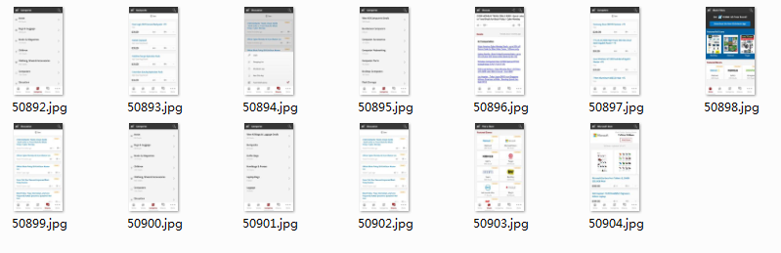
5apps_25
com.m.qr
com.advocare
com.roadtrippers
com.gaadi
net.slickdeals.blackfriday

Slide 33
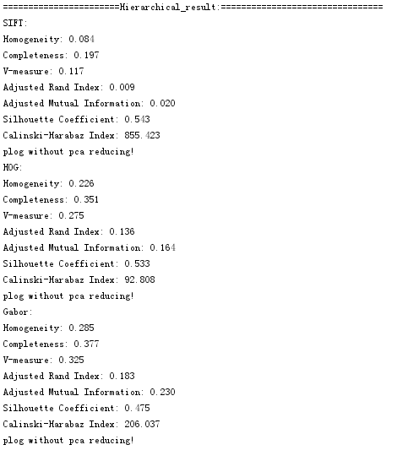
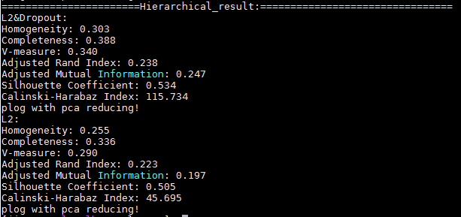
空白演示
Hierarchical
在此输入您的封面副标题

Slide 34
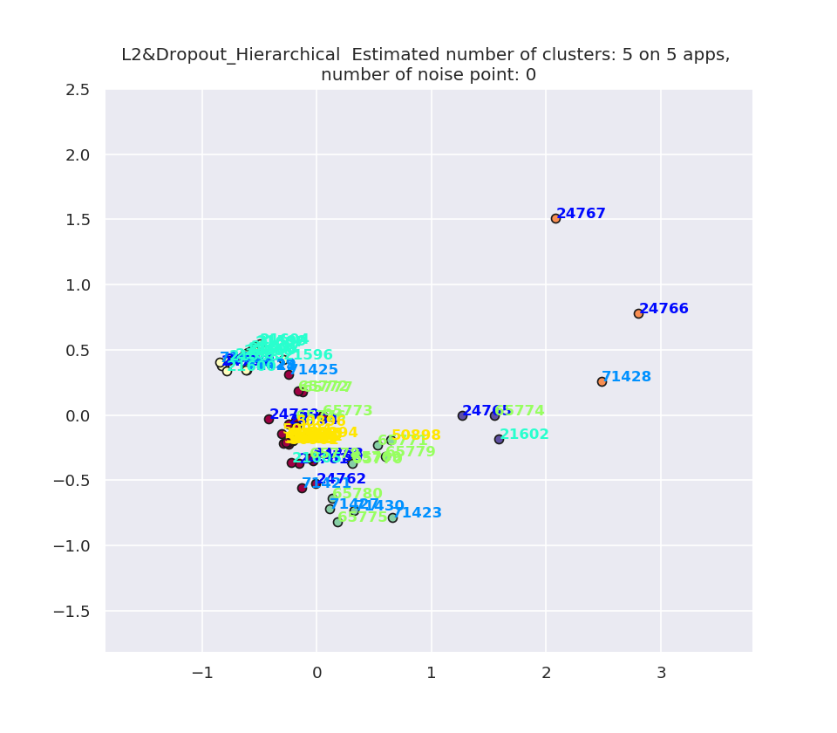
空白演示
在此输入您的封面副标题

Slide 35
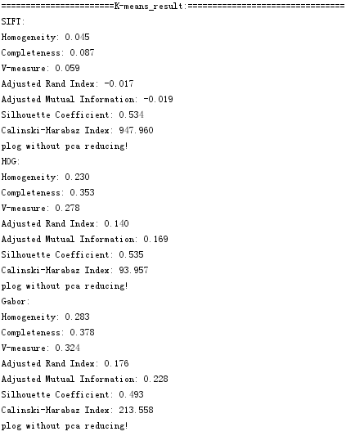
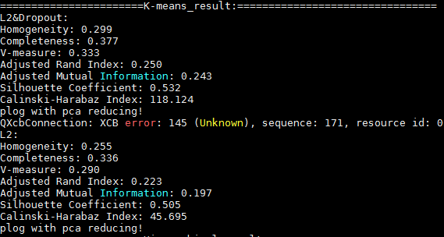
空白演示
K-means
在此输入您的封面副标题

Slide 36
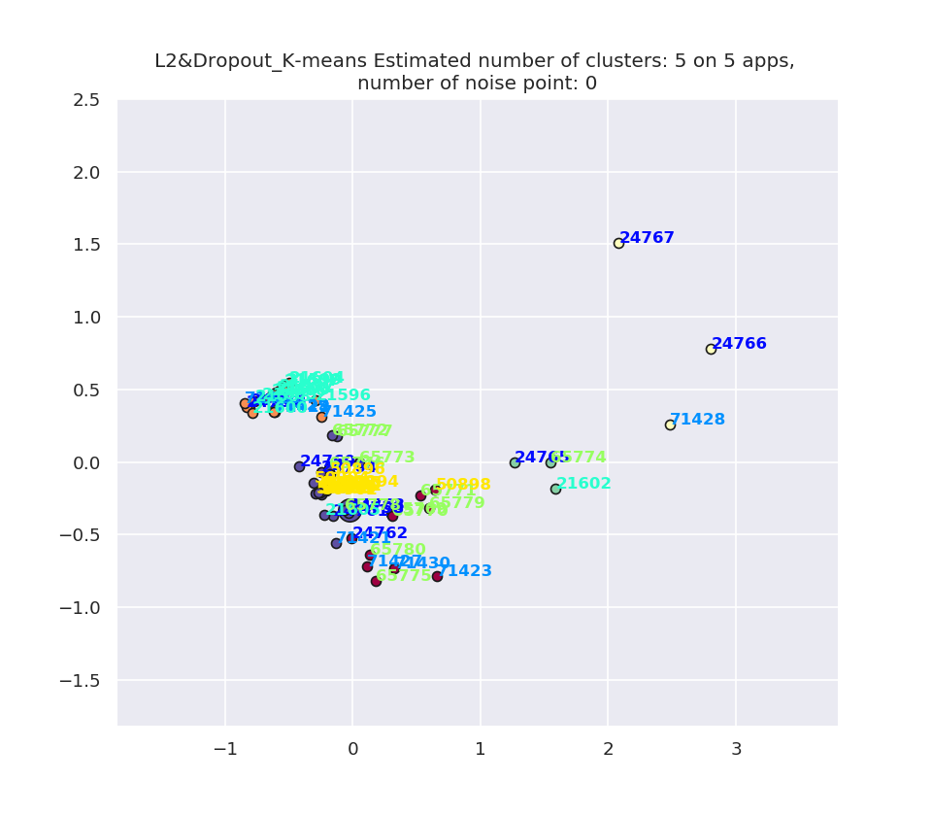
空白演示
在此输入您的封面副标题

Slide 37
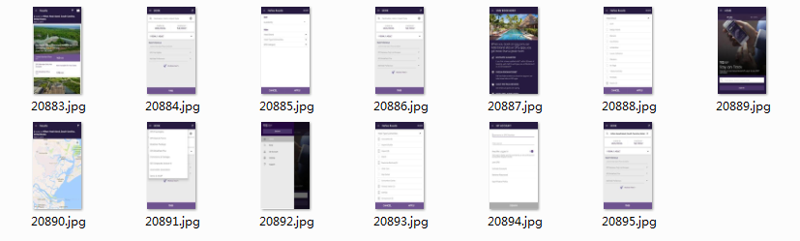
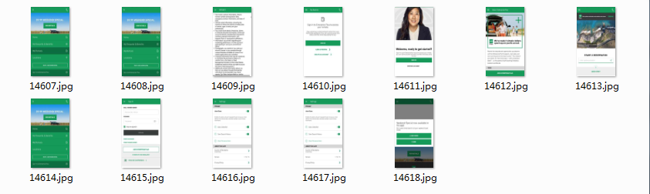
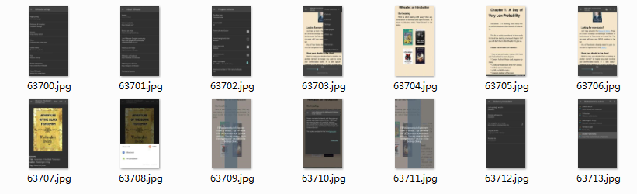
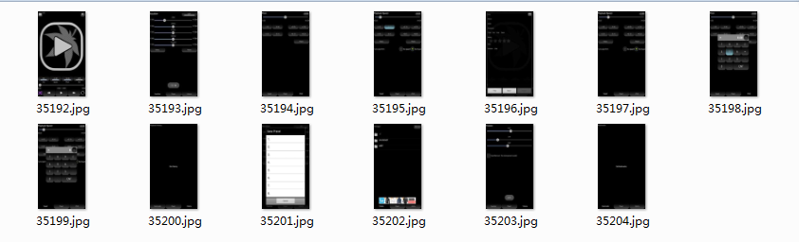
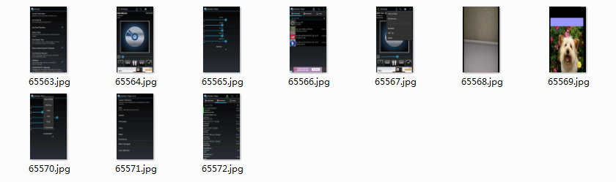
5apps_45
com.starwood.spg
com.ehi.enterprise.android
org.geometerplus.zlibrary.ui.android
com.sqr5.android.audioplayer
org.iii.romulus.meridian

Slide 38
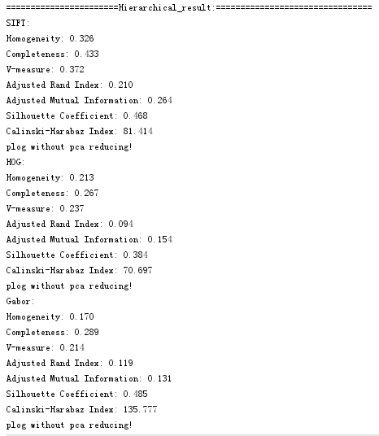
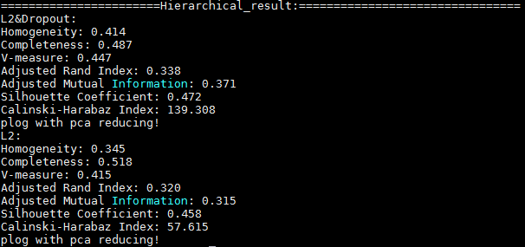
空白演示
Hierarchical
在此输入您的封面副标题

Slide 39
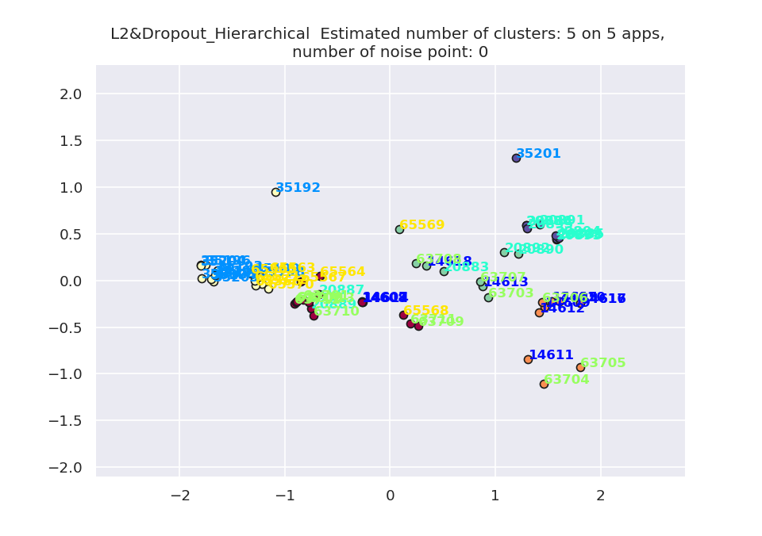
空白演示
在此输入您的封面副标题

Slide 40
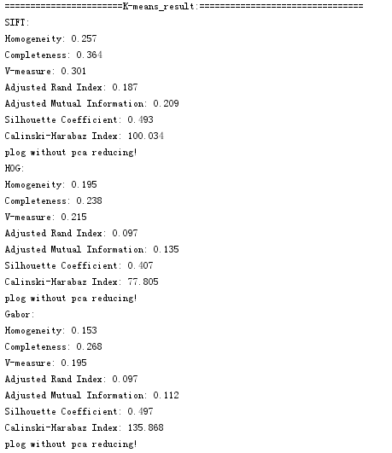

空白演示
K-means
在此输入您的封面副标题

Slide 41

空白演示
在此输入您的封面副标题

Slide 42


Comparison of Z-score andMin-Max
Z-score
Min-Max

Slide 43


design-style

Slide 44





Slide 45





Slide 46



Slide 47



Slide 48



